Slide 1
SECURITY & SURVEILLANCE FOR TEACHERS AND STUDENTS
PIP2001 Capestone Project
Review-1
Batch Number: CCS-G29
Roll Number | Student Name
20211CCS0065 | Chandrashekhar S
20211CCS0067 | Shubha K A
20211CCS0104 | Augustian P B
20211CCS0131 | Kavya Jaishree
Under the Supervision of,
Ms. Soumya
Assistant Professor
School of Computer Science and Engineering
Presidency University
Name of the Program: B. Tech
Name of the HoD: Dr. Anandaraj S P
Name of the Program Project Coordinator: Dr. Sharmasth Vali Y
Name of the School Project Coordinators: Dr. Sampath A K / Dr. Abdul Khadar A / Mr. Md Ziaur Rahman

Slide 2
Introduction
Managing URL filtering policies in Cisco Firepower Management Center (FMC) is essential for network security but can be challenging for non-technical users, such as teachers, who need to make frequent changes. The standard FMC GUI offers powerful capabilities but lacks simplicity for users unfamiliar with network security configurations.
This project proposes the development of a custom administrator webpage to provide a more user-friendly approach for managing URL filtering policies. It is built using Flask (a Python-based web framework) and Bootstrap (a responsive front-end framework), the webpage allows teachers to easily add or remove URLs from the filtering policies without the need to navigate through the complex FMC interface.
By leveraging FMC’s REST API, the webpage communicates with FMC to automate tasks such as policy updates and URL management, all through simple GET/POST requests. Python scripts will manage the API requests, ensuring seamless and accurate updates to the security policies.

Slide 3
Literature Review
S.NO | METHOD | ADVANTAGES | LIMITATIONS
01 | Firewall GUI-Based URL Filtering | - Direct control - Advanced features - Centralized management | - Complex for non-technical users - Requires training
02 | Command-Line Interface (CLI) | - Full control - Flexible - Ideal for advanced users | - Non-intuitive - Prone to errors - Time-consuming
03 | Cloud-Based Filtering | - Scalable - Easy to deploy - Real-time filtering | - Reliant on internet - Limited on-premise control - Subscription costs
04 | Proxy-Based Filtering | - Centralized control - Customizable filtering | - Technical setup - Potential performance issues - Limited HTTPS support
05 | DNS-Based Filtering | - Simple setup - Low impact on performance | - Limited control - Lacks advanced features - Not ideal for enterprises

Slide 4
Literature Review(Cont.)
S.NO | METHOD | ADVANTAGES | LIMITATIONS
06 | Endpoint Security Software | - Integrated with device security - Consistent enforcement | - Resource-intensive - Less scalable for large networks
07 | Manual Whitelisting/Blacklisting | - Simple for small-scale networks | - Not scalable - Requires constant updates - Lacks flexibility
08 | Browser Plugins | - Easy to deploy on individual devices | - Lacks centralized control - Easily bypassed - Not suitable for large networks
09 | Machine Learning-Based Filtering | - Dynamic filtering - Real-time threat detection | - Expensive - Resource-intensive - Requires tuning

Slide 5
Existing Methods
Direct FMC Management (GUI-based)
Firepower Management Center CLI/Script-Based Configuration
IT Support/Help Desk Model
DRAWBACKS:
Lack of User-Friendliness for Non-Technical Users
Dependency on IT Departments
Risk of Misconfiguration
Scalability Issues
Limited Granular Control
Complex Policy Management

Slide 6
Proposed Method
The proposed method aims to develop a user-friendly administrator webpage that allows non-technical users, such as teachers, to easily manage URL filtering policies in Cisco Firepower Management Center (FMC) using its REST API. This solution eliminates the complexity of FMC’s native GUI, making policy management more accessible.
Webpage Development (Flask + Bootstrap)
FMC API Integration
System Workflow
Security and Access Control
Testing and Deployment

Slide 7
Objectives
Simplify URL Filtering Management:
Develop an easy-to-use administrator webpage to allow non-technical users, such as teachers, to add or remove URLs in the Firepower Management Center (FMC) without navigating its complex GUI.
Improve Accessibility:
Provide a more accessible solution for managing URL filtering policies by utilizing FMC’s REST API, reducing reliance on technical expertise and simplifying the process for users who lack network security knowledge.
Enhance Policy Control:
Ensure secure and efficient policy management through a centralized platform that maintains the integrity of access control policies while allowing rapid updates to URL filtering rules.

Slide 8
Methodology
User Authentication (Microsoft Active Directory)
Method: Identity Policy via AD Authentication
Description: Verifies user credentials against Active Directory for role-based access control (RBAC).
Role-Based Access Control (RBAC)
Method: Role Verification
Description: Checks user roles (admin/teacher) to grant appropriate access to URL filtering management.
URL Filtering Management
Method: REST API (POST/GET) to Firepower Management Center
Description: Admins and teachers manage URL filtering by sending requests to the FMC API.
Frontend-Backend Interaction
Method: Flask Framework
Description: Facilitates user requests, session management, and interaction with backend processes.

Slide 9
Methodology(cont..)
Database Management
Method: MongoDB
Description: Stores user credentials and logs actions related to URL policy changes.
Data Validation and Error Handling
Method: Input Validation
Description: Validates user inputs at both frontend and backend to prevent security vulnerabilities.
HTTP Session Management
Method: Flask Session Management
Description: Tracks user login states and roles securely during web interactions.
API Integration
Method: RESTful APIs
Description: Communicates with external services (FMC, AD) for data exchange in JSON format.

Slide 10
Methodology(cont..)
User Interface Design
Method: Bootstrap Framework
Description: Creates a responsive, user-friendly interface for the application.
Testing and Validation
Method: Unit Testing, Integration Testing, UAT
Description: Ensures functionality and user satisfaction through various testing phases.

Slide 11
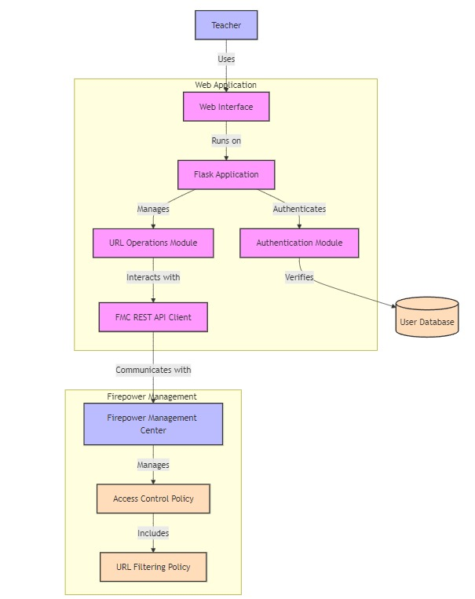
Architecture

Slide 12
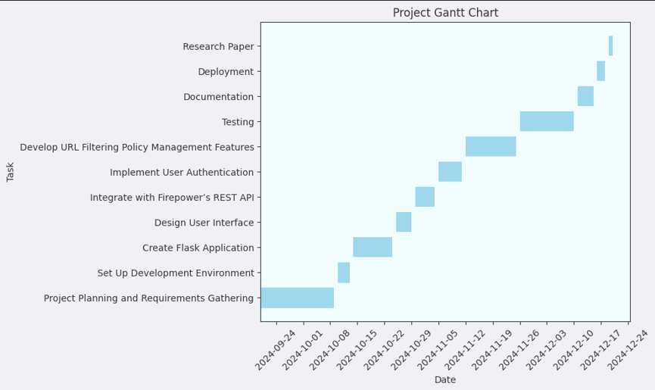
Timeline of Project

Slide 13
Expected Outcomes
Simplified URL Policy Management : The administrator webpage makes it easy for non-technical users, like teachers, to add or remove URLs in the URL filtering policy without needing advanced technical knowledge.
Increased Accessibility : The user-friendly interface allows teachers to manage URL filtering independently, reducing reliance on network administrators.
Faster Policy Updates : Real-time interaction with FMC's REST API ensures that URL filtering changes are applied immediately, improving the efficiency of policy management.
Secure Access Control : The webpage ensures that only authorized users can modify URL filtering rules, maintaining the integrity and security of the system.
Lower Administrative Workload : Automating URL filtering tasks through the webpage reduces the manual effort and time required for network administrators to manage access control policies.

Slide 14
Conclusion
In conclusion, this project aims to simplify URL filtering management for teachers by creating a user-friendly web interface. By leveraging Flask and Bootstrap, we provide an intuitive platform that allows teachers to easily add or remove URLs in Access Control Policies without needing to navigate the complex Firepower Management Center GUI.
The integration with Firepower's REST API ensures seamless communication for policy updates, while the use of Microsoft Active Directory for authentication maintains a secure environment. With robust role-based access control and comprehensive data validation, this solution enhances user experience while ensuring security and efficiency.
This project not only empowers teachers to manage URL filtering more effectively but also streamlines administrative tasks, contributing to a safer and more controlled online environment for educational purposes.

Slide 15
References
https://www.cisco.com/c/en/us/td/docs/security/firepower/610/configuration/guide/fpmc-config-guide-v61/fpmc-configguide-v61_chapter_01110011.html
https://www.cisco.com/c/en/us/td/docs/routers/sdwan/configuration/security/ios-xe-16/security-book-xe/url-filtering.pdf
https://ieeexplore.ieee.org/document/9501961
https://doi.org/10.13052/jwe1540-9589.2345
https://www.cisco.com/c/en/us/td/docs/security/firepower/630/configuration/guide/fpmc-config-guidev63/create_and_manage_identity_policies.html
https://www.cisco.com/c/en/us/td/docs/security/firepower/710/fdm/fptd-fdm-config-guide-710/fptd-fdm-identity.html
https://www.cisco.com/c/en/us/td/docs/security/firepower/650/api/REST/Firepower_Management_Center_REST_API_Quic k_Start_Guide_650.pdf

Slide 16

Project work mapping with SDG
This project directly supports Goal 4 (Quality Education) and Goal 9 (Industry, Innovation, and Infrastructure) by improving access to educational resources and making technology more user-friendly. It also aligns with Goal 16 (Peace, Justice, and Strong Institutions) by enhancing security, transparency, and accountability in digital environments. Indirectly, it touches on Goal 8 (Decent Work and Economic Growth) and Goal 10 (Reduced Inequalities) by improving workplace efficiency and access to technology for all staff members.

Slide 17
Thank You

